Slide 1
IO Lab
Spring 2016
Module 2 - Lec 1 - HTML
Jan 27, 2016

Slide 2




Course Map
Getting Started
Front End
Back End
Advanced Topics
Introduction
Fundamentals
Git
Command Line
HTML
CSS
Responsive Design
JavaScript & jQuery
Web Frameworks
Architecture
Database Design
APIs
Visualization
Security
Deployment

Slide 3
Course Map
Getting Started
Front End
Back End
Advanced Topics
Fundamentals
Git
Command Line
HTML
CSS
Responsive Design
JavaScript & jQuery
Web Frameworks
Architecture
Database Design
APIs
Visualization
Security
Deployment

Slide 4
Front End Module
HTML
CSS & Responsive Design
JavaScript & jQuery

Slide 5
Front End Module - HTML
HTML
CSS & Responsive Design
JavaScript & jQuery

Slide 6
Goals Today
Foundational understanding of HTML
Brush up & fill in the gaps
Think & design before coding

Slide 7

HTML
Hypertext
Markup
Language

Slide 8
HTML - Hypertext & Markup
Hypertext - text that links to other documents & resources
Markup - annotation of content for definition, display, and processing

Slide 9
HTML - What is it?
A predefined vocabulary and set of rules for creating Web pages
A set of standards recommended by the W3C (Worldwide Web Consortium)
Borne out of older markup languages like GML & SGML
Dig deeper with the W3C Spec

Slide 10

Wait, what is the W3C?
“The World Wide Web Consortium (W3C) is an international community where Member organizations, a full-time staff, and the public work together to develop Web standards.”
- W3C website
Mission: “To lead the Web to its full potential.”

Slide 11

Tim Berners-Lee
Currently the Chair of the W3C
Wanted a way to share research across different systems at CERN
Proposed what would become
The Web
HTTP
HTML
Visualizing the Web’s timeline The W3C version of history

Slide 12
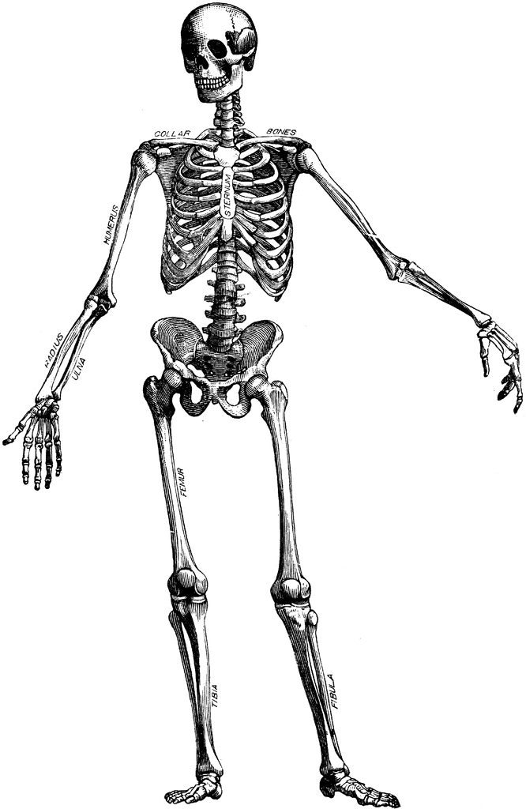
HTML - Content and Structure
Contains a web page’s content to be rendered, whether it’s hard-coded or dynamically generated
Provides structure to a web page
It’s like the skeleton of a web page

Slide 13
HTML vs XML
HTML | XML
Used to display data Pre-defined vocabulary Forgiving syntactical rules Focus on human readability Focus on Web development | Used to describe/store data User-defined vocabulary Strict syntactical rules Focus on machine readability Focus on transactional documents
For more on XML, check out the W3C spec

Slide 14
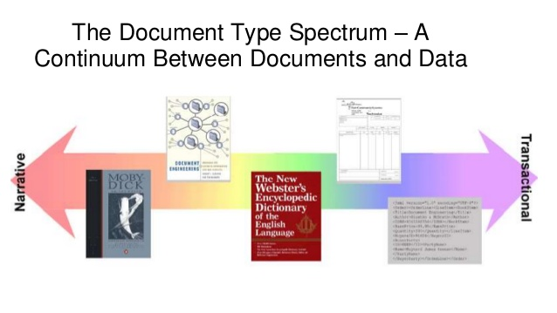
HTML, XML, & The Document-Type Spectrum
HTML
XML
We’ll primarily be focusing on HTML in this course

Slide 15
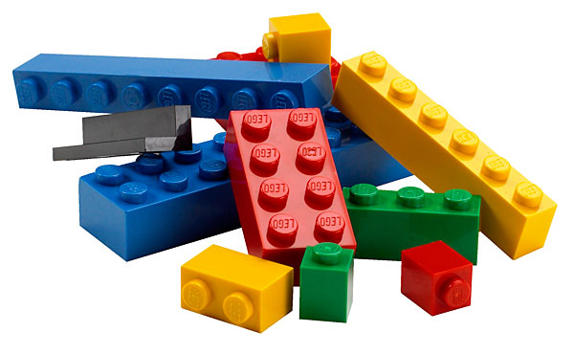
HTML - Elements & Tags
Elements are the building blocks of HTML
Tags are used to mark beginning & end of an element
Opening tags and closing tags: <> </>
ex: <p>This is a paragraph</p>
The content between the opening and closing tags is rendered
In the above paragraph element, “This is a paragraph” is the content and will be rendered

Slide 16
HTML - Elements & Tags
element
content
<p>This is a paragraph</p>
opening tag
closing tag

Slide 17
HTML - Common Element Types
div (division) - used for sectioning & styling; no semantic value!
span - used for small bits of text & styling; no semantic value!
h1 - h6 - headers, ranging in hierarchical importance
p (paragraph) - used for larger blocks of text
a (anchor) - used to link to other web pages, internal or external
ol & ul - ordered and unordered lists (i.e., numbered & bulleted lists)
img (image)
button

Slide 18
HTML - Common Element Types Cont’d.
form - used for user input/forms
nav - used for navigation-specific content
header - not the <head> element
article - used for the main text of a web page; great for syndication
section - used for grouping related content
aside - used for tangential content, like a block quote
footer - used at bottom of page
for even more tags, check out HTML Dog’s tag reference

Slide 19
HTML - Structure & Meaning Using Types
<header>
<article>
<aside>
<h1>
<p>
<footer>

Slide 20
HTML - Structure & Meaning - You Try It!
Pair up with someone next to you
Go to http://www.techcrunch.com and find the first story about Werner Herzog from Jan 21, 2016
Take 5 minutes to draw out on paper how you would organize & nest the content using different elements (don’t use page source!)
Try not to use divs or spans
Ignore the right-hand sidebar and social media buttons

Slide 21
HTML - Attributes
Properties that give additional information about an element
Element-level metadata
Used to style elements, locate resources, and provide a ‘handle’ for Javascript & jQuery
Located in opening tag
Ex: <div id=”example-div” class=”left wide”>Example Div</div>
Consist of a name and a value
Ex: href=”http://www.google.com”
Some elements require attributes (e.g., anchors), while others don’t (e.g., divisions)

Slide 22
HTML - Common Attribute Types
href (hyperlink reference) - links to other pages (internal or external)
class - identifies groups of elements to be styled or interacted with similarly
id - uniquely identifies an element, often for styling, Javascript, or as a fragment identifier
src - links to source media, often images
alt - alternate content to be displayed, often used by screen readers; try to have alt attributes whenever possible

Slide 23

HTML - Comments
Always comment your code - for yourself and for others
Comments enclosed by comment tags: <!-- -->
Ex: <!-- This is a comment -->
What was I thinking when I wrote this?

Slide 24
HTML - Good, Clean Code
Just like comments are important, writing clean, readable code is crucial
Be semantic
Use comments
Use appropriate spacing
Use indentation
Use appropriate naming conventions
Here is a roundup of best practices for writing clean HTML and CSS

Slide 25
HTML - Basic Document Structure
<!DOCTYPE html> - specifies document type; in this case, HTML
<html> - the root element; contains all other elements in the HTML doc
<head> - a container for the web page’s metadata; this info is not displayed
<meta> - a specific piece of metadata about web page, such as the text encoding (UTF-8 is common)
<title> - title of web page
<link> - link to additional resources, such as CSS or JS files; can be internal or external
CSS files in the head
<body> - contains the page’s visible content
<link> to JS files at the end of body

Slide 26
HTML - Basic Structure Example
<!DOCTYPE html>
<html>
<head>
<meta charset=”utf-8”>
<title>A Very Simple Page</title>
</head>
<body>
<h1>This is a header</h1>
<p>Text goes here.</p>
</body>
</html>

Slide 27
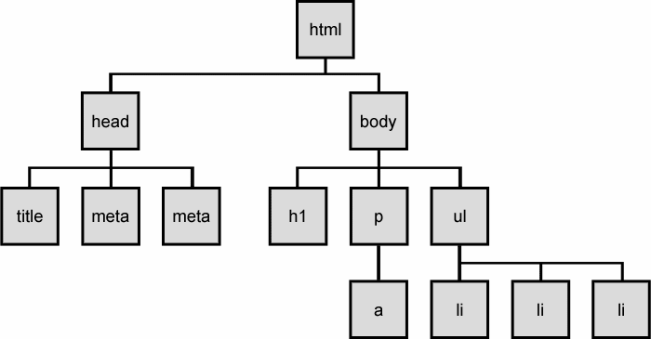
HTML - The DOM Tree
Document
Object
Model
Your browser converts HTML code into a virtual model (the DOM) for rendering and manipulation

Slide 28
HTML - Semantic Code
Assign meaning based on content, not style/presentation
Machine-understandable
Search engines, screen readers, RSS feeds, etc.
Human-understandable
Describe type of content (divs & spans don’t inherently do this)
Always assume other people will read your code!

Slide 29
HTML - Semantic Code - Unrealistic?
It is best practice to be semantic when possible
Strive to be semantic, but don’t let it hold you back
Many modern web pages != traditional written publications
Sometimes a div is less confusing than awkwardly using a ‘semantic’ tag

Slide 30
HTML - Unsemantic & Semantic Example
Unsemantic Code | Semantic Code
<div class=’footer’>Content</footer> | <footer>Content</footer>
<span class=’main-heading’>Content</span> | <h1>Content</h1>

Slide 31
HTML - Semantics via RDF
RDF (Resource Description Framework) is a W3C recommendation used to define relationships between entities and make content more machine-understandable
Directional relationships in the form of triples
Subject (Resource) -- Predicate(Property) -- Object(Literal)
Ex:
Jeff Bezos
www.amazon.com
creator
for more, check out the W3C spec

Slide 32
Architectural Thinking
This is a concept we’ll revisit many times this semester
Separation of concerns
Modular
Reusable
Maintainable
Presentation
Logic
we are here
Content (Resources)

Slide 33
Architectural Thinking cont’d.
Assign ids & classes strategically
Give elements with common styling a single class to avoid repetition and make your life easier when changing styling
Name classes and ids based on content/purpose, not styling
Avoid using in-line styling
This is different from using <strong> and <em> semantically
Leave the styling to CSS, whenever possible

Slide 34
HTML - In-Class Workshop
Code your drawn-out TechCrunch page from earlier
Work in pairs
Find instructions in the Labs folder under the Files section of bCourses

